Slide 1
Typescript
Alexandru Bereghici abereghici@pentalog.com

Slide 2
Summary
Introduction in Typescript
Typescript Features
Typescript Playground
The TypeScript Toolchain
Working with TSC

Slide 3
Introduction to Typescript

Slide 4
Why Typescript
There are two main goals of TypeScript:
Provide an optional type system for JavaScript.
Provide planned features from future JavaScript editions to current JavaScript engines

Slide 5
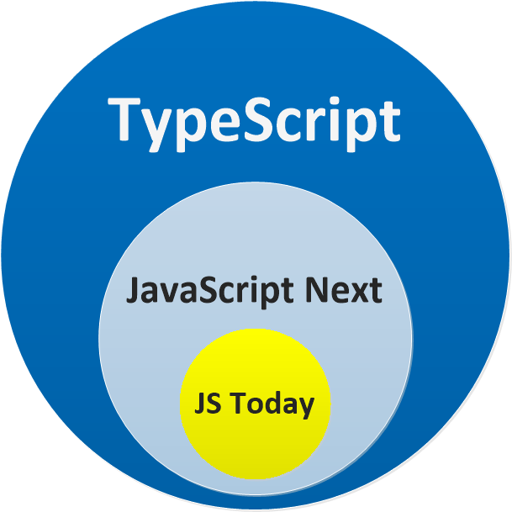

Slide 6
Making Javascript Better
[] + []; // JavaScript will give you "" (which makes little sense), TypeScript will error // other things that are nonsensical in JavaScript // - don't give a runtime error (making debugging hard) // - but TypeScript will give a compile time error (making debugging unnecessary) // {} + []; // JS : 0, TS Error [] + {}; // JS : "[object Object]", TS Error {} + {}; // JS : NaN or [object Object][object Object] depending upon browser, TS Error "hello" - 1; // JS : NaN, TS Error function add(a,b) { return a + b; // JS : undefined, TS Error 'unreachable code detected' }

Slide 7
Typescript Features

Slide 8
Types
JavaScript does in fact have types, they're just "duck typed", which roughly means that the programmer does not have to think about them. JavaScript's types also exist in TypeScript:
boolean (true/false)
number integers, floats, Infinity and NaN
string characters and strings of characters
[] Arrays of other types, like number[] or boolean[]
{} Object literal
undefined not set
TypeScript also adds
enum enumerations like { Red, Blue, Green }
any use any type
void nothing

Slide 9
Primitive type example:
let isDone: boolean = false; let height: number = 6; let name: string = "bob"; let list: number[] = [1, 2, 3]; let list: Array<number> = [1, 2, 3]; enum Color {Red, Green, Blue}; let c: Color = Color.Green; let notSure: any = 4; notSure = "maybe a string instead"; notSure = false; // okay, definitely a boolean function showMessage(data: string): void { alert(data); } showMessage('hello');

Slide 10
Interfaces
An interface is a TypeScript artifact, it is not part of ECMAScript. An interface is a way to define a contract on a function with respect to the arguments and their type. Along with functions, an interfacecan also be used with a Class as well to define custom types.
An interface is an abstract type, it does not contain any code as a class does. It only defines the 'signature' or shape of an API. During transpilation, an interface will not generate any code, it is only used by Typescript for type checking during development.

Slide 11
Interface example
interface LabelledValue { label: string; } function printLabel(labelledObj: LabelledValue) { console.log(labelledObj.label); } let myObj = {size: 10, label: "Size 10 Object"}; printLabel(myObj);

Slide 12
Shapes
Underneath TypeScript is JavaScript, and underneath JavaScript is typically a JIT (Just-In-Time compiler). Given JavaScript's underlying semantics, types are typically reasoned about by "shapes". These underlying shapes work like TypeScript's interfaces, and are in fact how TypeScript compares custom types like classes and interfaces.

Slide 13
Shapes example
interface Action { type: string; } let a: Action = { type: 'literal' } class NotAnAction { type: string; constructor() { this.type = 'Constructor function (class)'; } } a = new NotAnAction(); // valid TypeScript!

Slide 14
Decorators
A Decorator is a special kind of declaration that can be attached to a class declaration, method, accessor, property, or parameter. Decorators use the form @expression, where expression must evaluate to a function that will be called at runtime with information about the decorated declaration.

Slide 15
Typescript playground

Slide 16
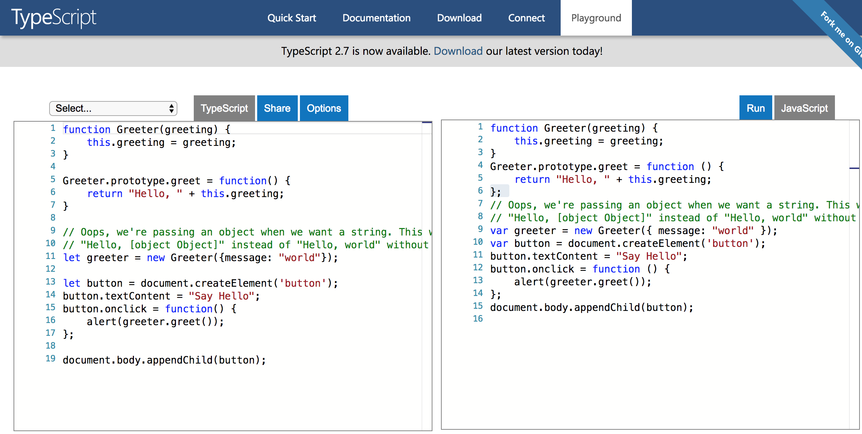
https://www.typescriptlang.org/play/index.html

Slide 17
The TypeScript Toolchain

Slide 18
Installing TypeScript
> npm install -g typescript (https://github.com/Microsoft/TypeScript)
> npm install -g ts-node
(https://github.com/TypeStrong/ts-node)
> npm install -g npx
(https://github.com/zkat/npx)

Slide 19
tslint
Using a linter when coding is a must to quickly know about inconsistencies, syntax errors and omissions. The de facto linter for TypeScript is tslint.
Let’s go ahead and install/configure tslint into our project.
# for installing globally: $ npm i tslint --g # for installing locally: $ npm i tslint --save-dev

Slide 20
Working
with TSC

Slide 21
Working with tsc
So far tsc has been used to compile a single file. Typically programmers have a lot more than one file to compile. Thankfully tsc can handle multiple files as arguments.
Imagine two ultra simple files/modules:
a.ts
export const A = (a) => console.log(a);
b.ts
export const B = (b) => console.log(b);
$ tsc ./a.ts ./b.ts $ ls a.js a.ts b.js b.ts

Slide 22
Watch mode
Instead of running the TypeScript compiler every time you make a change, you can start the compiler in watch mode instead so that it recompiles every time there are changes to the TypeScript files:
$ tsc -w

Slide 23
tsconfig.json
Telling the tsc command what to compile becomes tedious and labor intensive even on small projects. Fortunately TypeScript has a means of simplifying this. tsconfig.json files let programmers write down all the compiler settings they want. When tsc is run, it looks for tsconfig.json files and uses their rules to compile JavaScript.

Slide 24
tsconfig.json
{ "compilerOptions": { "module": "commonjs", "target": "es5", "emitDecoratorMetadata": true, "experimentalDecorators": true, "noImplicitAny": false, "removeComments": false, "sourceMap": true }, "exclude": [ "node_modules", "dist/" ] }

Slide 25
Resources

Slide 26
Resources
https://angular-2-training-book.rangle.io/handout/features/typescript_classes.html
https://www.udemy.com/complete-typescript-2-course/
https://www.typescriptlang.org/docs/home.html
https://hackr.io/tutorials/learn-typescript
https://github.com/TypeStrong/learn-typescript
https://basarat.gitbooks.io/typescript/
https://alligator.io/typescript/new-project/

